Slide 1
Git - Github

Slide 2
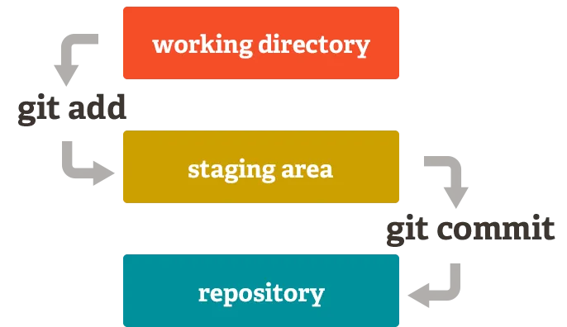
To simplify Things

Slide 3
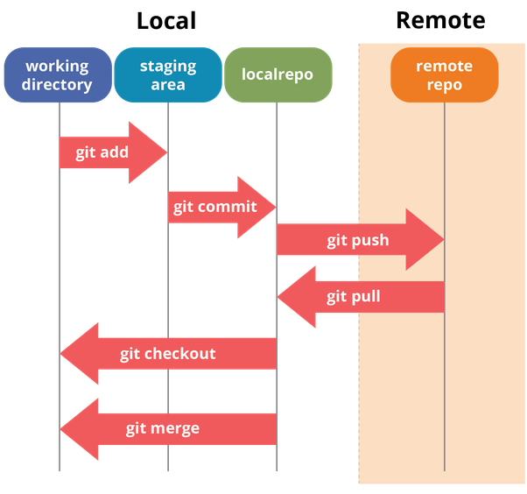
Git environments
3 environments / 3 states
Modified
Staged
Committed
Working Dir:
Single checkout of your project
Staging Dir:
Where you store files you will commit to your repository
Local repo:
It is what will be copied over to remote

Slide 4
Local file directory
Files not tracked by Git - Untracked files
Git is unaware of their existence until you Add them to your working directory.

Slide 5
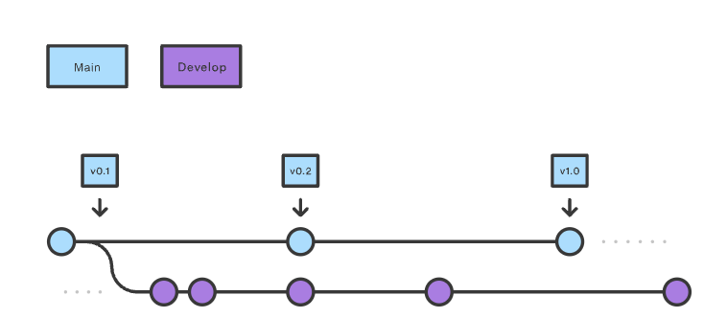
Gitflow

Slide 6

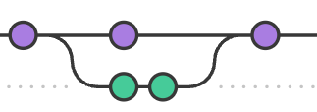
Feature branch

Slide 7
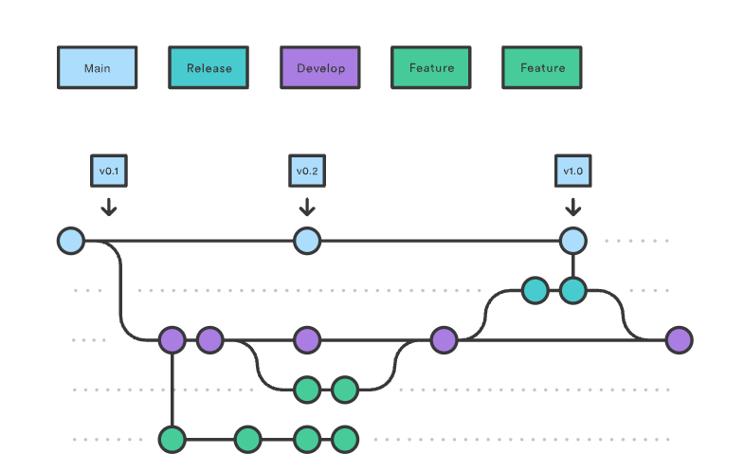
Full workflow

